Slide 1
Using the 3 E’s for Purposeful Career Guidance
Jonathan Butler, Ma, RES
Career Coach

Slide 2
Defining Purpose
The determined, intentional pursuit of accomplishing professional and personal goals that will lead to finding meaning and intrinsic fulfillment.
Found meaning enhances well-being, job satisfaction, and overall quality of life.

Slide 3
Finding purpose
Passion
Proficiency
Purpose Found

Slide 4
Barriers to Purposeful attainment: Low GRIT
Low GRIT
Low passion, unwilling to put forth effort, Low perseverance
Understand student/customer motivations (Identify Passion)
Setting SMART goals (Encourage effort)
Empower with autonomy (Enhance Perseverance)

Slide 5
Barriers to Purposeful attainment: No Discipline
No Discipline
The practice of training oneself to do something in a controlled, habitual way
Work through prioritizing and following through on commitments
Break down tasks, goals into smaller, simpler steps
Requires patience and deliberate practice

Slide 6
Barriers to Purposeful attainment: YOU!
(Parents, teachers, social workers, counselors)
Low expectations lead to low student performance and achievement. Believe in human potential!
Consider Individual Differences. One size does not fit all!
CAN do vs. CAN’T do list. Strength's assessments
Normalize failure and problem solve strategies to overcome them

Slide 7
Presentation Highlights
Examine: examine themselves, their interests, skills, and abilities
Explore and Equip: Tools & resources to explore careers & educational opportunities.
Execute: Turning Plans into action. Where are the jobs??

Slide 8
Examine
Creating, or reinventing your Future self

Slide 9
World and U.S. Total Population
8.0 Billion- World Population
335.8 Million United States Population
(United Nations, 2022)

Slide 10
Career Exploration Begins With You
INCREASE Self-Awareness:
Experiential learning
Informational Interviews
Assessments (career interests, personality, ability, etc.)

Slide 11
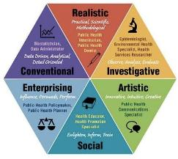
Holland Code RIASEC Assessment
My Next Move
Texas Career Check

Slide 12
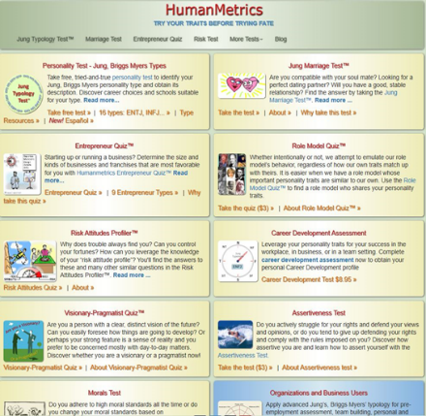
Personality Assessments
HumanMetrics Personality
Enneagram Personality

Slide 13
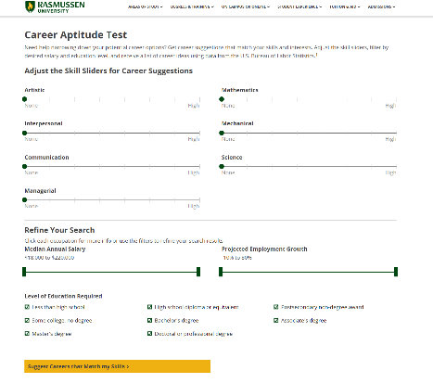
Career Aptitude Assessments
Rasmussen University Career Aptitude
What Career is Right for Me?

Slide 14
Focus on the Customer
What is the customer interested in? What are they good at? What are their limitations?
Does their career goal require post-secondary training and education? If so, how can they get there?
Will their career goal require them to relocate to pursue training? Or secure employment?
What resources can the customer access within their communities?
(True or False) People need to go to either the military, or college to be successful and find a good paying job.
(FALSE)

Slide 15
Explore & Equip

Slide 16
Purposeful Careers

Slide 17
The Great Debate
JOBS Careers
Is there really a difference?

Slide 18
Some Considerations
JOBS
CAREERS
A position you choose to do, to fulfill one’s purpose
Longevity
Personal investment of time and energy to achieve goals
Often requires specialized training
Primary goal: Expertise or personal fulfillment
Usually a position you “have” to do for survival
Short-term, position for “right now”
A cycle of turnover
Often available with little to no experience
Primary goal: Earn Money

Slide 19
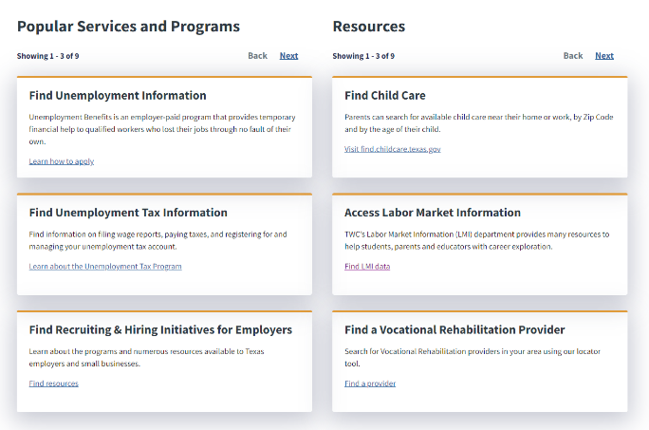
SAME Mission, New Site!
TWC.TEXAS.GOV

Slide 20
Career Exploration Tools & Resources

Slide 21
Use them with your Customers
Texas Reality Check

Slide 22
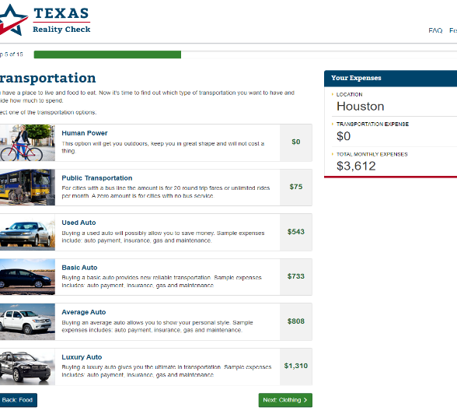
Texas Reality Check

Slide 23
Texas Reality Check

Slide 24
Texas Career Check

Slide 25
Occupational Trends (TEXAS)

Slide 26
Occupation Summary

Slide 27
Occupation Summary: Knowledge Areas

Slide 28
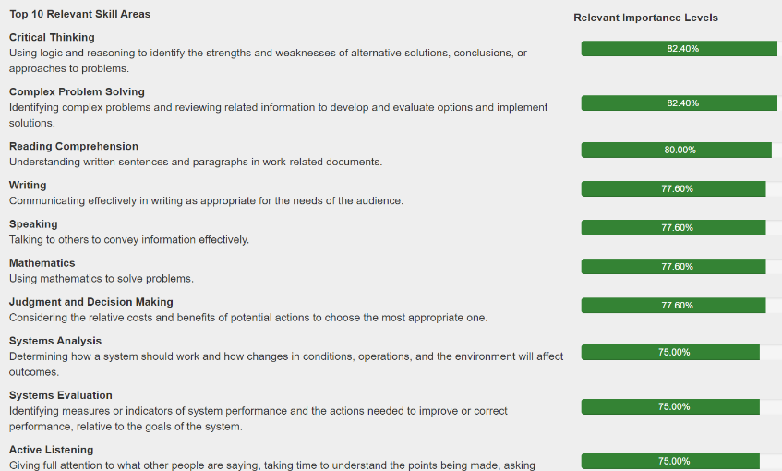
Occupation Summary: Skills

Slide 29
Occupation Summary: Abilities

Slide 30
Post-Secondary Option: Apprenticeships
Combining On-the-job training and classroom work with Mentorship
Earn college credits and certifications
800,000 apprenticeships secured nationally
$77,000 Average Starting Salary
93% Employee Retention

Slide 31
Alternative Post-Secondary Options
Employer Tuition Assistance Programs
Workforce Training Programs
*Not an advertisement for companies displayed

Slide 32
Think! Plan! Execute!

Slide 33
Texas Workforce Commission
To promote and support a workforce system that creates value and offers employers, families, individuals, and communities the opportunity to achieve and sustain economic prosperity.
TWC is designed to:
Support and strengthen our workforce system
Serve people in the State of Texas
Provide opportunities to reach careers that will provide a sustainable income
Collaboration & Coordination with our Workforce Partners

Slide 34
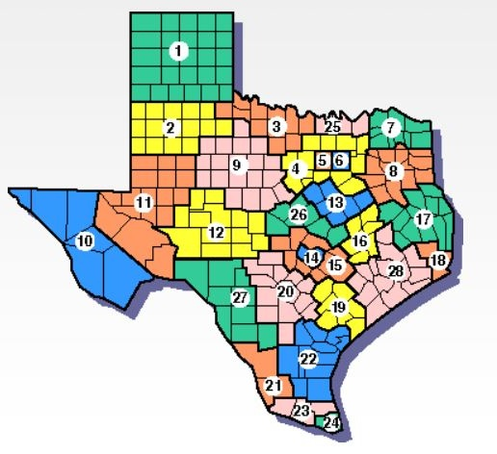
Workforce Solutions Boards and Partners

Slide 35
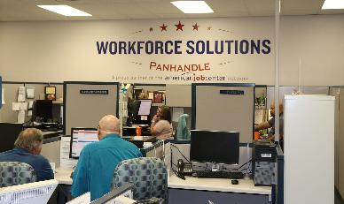
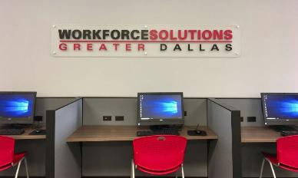
Workforce Solutions Offices
Resource Center
Employment Specialists
Free Workshops (In-person & Virtual)
Access to Job Fairs
Case Management Services
Region-specific programs for job seekers
WFS Offices available throughout the State

Slide 36
Adult Education Literacy (AEL)
Serves job seekers that are 16 or older
Serves ESL job seekers
Provide free English, math, reading, and writing classes
Gain access to resources such as tutors
Assistance in overcoming barriers to employment
This Photo by Unknown Author is licensed under CC BY-SA

Slide 37
Special Populations
Foster Youth Texas College Tuition & Fee Waiver & The Education/ Training Voucher
Vocational Rehabilitation Services

Slide 38
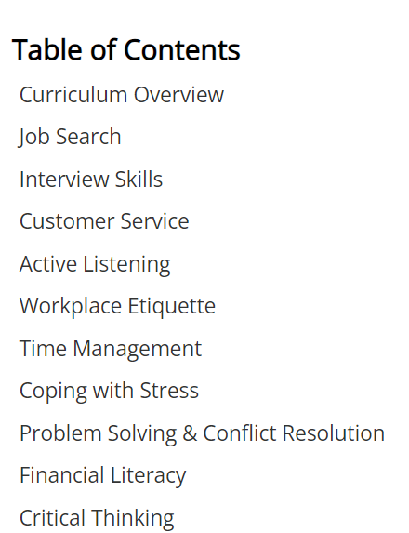
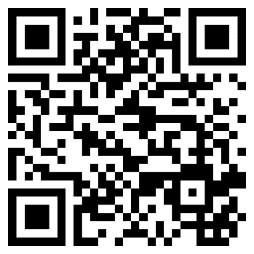
Job Readiness Training Modules & Cert. of Completion
https://www.livebinders.com/play/play?id=2172994

Slide 39
Where Can You Find Jobs?
1. Networking/Social Networking
2. Referrals
3. Job Fairs
4. Company Websites
5. Cold Calling
6. Headhunters/Recruiters
7. Temp Agencies
8. Creative Tactics
9. Job Search Websites

Slide 40
WorkinTexas.com
Search for and apply for jobs
Translated into Spanish
More secure than other job search websites
Employers find YOU!
Resume Builder and feedback
Access to local resources and workshops
Access to real-time, Texas labor market data

Slide 41
Access to Additional Resources

Slide 42
Career Information Hotline
24/7 automated line
Get career or college information
3 careers
3 colleges/universities
Can call more than once
Anyone can call
Counselor Packets
1-800-822-PLAN (7526)

Slide 43
“Your work is going to fill a large part of your life, and the only way to truly be satisfied is to do what you believe is great work. And the only way to do great work is to Love what you do” - Steve Jobs

Slide 44
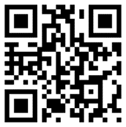
Contact Information
Jonathan E. Butler, MA, RES
Jonathan.butler@twc.texas.gov
Mobile: 737.266.1326
Workforce Development Division
Texas Workforce Commission
careerinformation@twc.texas.gov

