Slide 1
Looking Back, Looking Forward: The Ongoing Mission of Disability Support Professionals
Shawn P. Saladin, PhD, CRC, CPM

Slide 2
Introduction
Welcome and brief personal journey overview
Importance of reflecting on barriers, accommodations and looking ahead
Inspire continued advocacy and building bridges to success

Slide 3
Where to begin?

Slide 4
That boy aint right…..

Slide 5
First Exposure to an Audiologist

Slide 6
Cortez Elementary: Albuquerque, N. M.
Two aural classes of students with hearing loss
Accommodations
Own hearing aid
Test hearing aids
Hard wired desk
First FM loop
8 in my class
Speech three times a week for five years
The rest of the school was regular education

Slide 7
PL 94-142
5th grade
Mainstreamed
Accommodations
Headphones on me
Large microphone worn by the teacher
You or your kind

Slide 8
Milpitas, California
Rose Elementary: Is this 5th grade or 6th grade?
Accommodations?
Rancho Milpitas Middle School:
Accommodations?
a lonely scary place

Slide 9
Edwards Airforce Base
Forbes Jr. High
Back to eight in a class!
Accommodations?
Got to teach the geography class
Start thinking about what to do for a living when finished with school
Desert High School
Accommodations?
I want chemistry class; sorry you are on the Slow Track.
What do engineers do?
What is a PhD?
Found success in drafting

Slide 10
Naples, Italy
Accommodations?
Fun times
Not allowed to work
Crabbing with Gator?
Eighteenth birthday, got luggage.

Slide 11
Sacramento, California
Gotta get a job!
American River College
I'm a resident of Michigan?
Strawberries

Slide 12
San Antonio, Texas
San Antonio College
Remedial everything
What’s TRC?
Denied
Accepted
Great VRC’s
Stared as certificate in drafting
Ended up almost Associates of Applied Science in Engineering Technology
TRC paid for:
Tuition
Notetakers
New set of hearing aids

Slide 13
Bryan/College Station
Texas A&M
Accommodations?
Engineering Technology
Chemistry Class
TEEX
Industrial Education
Internship at Texas School for the Deaf “DPN”
BS Degree ‘86
Would you mind living on the other side of town?
You can’t hear the bell; you will put the kids in danger
MEd ‘88

Slide 14
University of Texas at Austin
Program: PhD in Special Education, Rehabilitation Counselor Education program
Accommodations
Interpreters
FM Loop
Preferential seating
Dr. Parker
Gregory Gym

Slide 15
Texas School for the Deaf
ACCESS: Adult Curriculum for Community, Employment, and Social Skills
More dual enrollment programs with Austin Community College
The jobs the students want now:
Electrical Engineer
Robotics Engineer
Real estate agent
Medical Doctor
Special Effects Artist (4th grader)

Slide 16
Call to Action
Must support and encourage each other to stay in the field
Develop new ways for the students to improve self efficacy
Student organizations
Monthly meetings with the director
Commitment to continuous improvement
Encourage students to take a risk with that harder class
Never lose sight of the need for people to chose their professions
Stay vigilant in protecting student’s rights

Slide 17
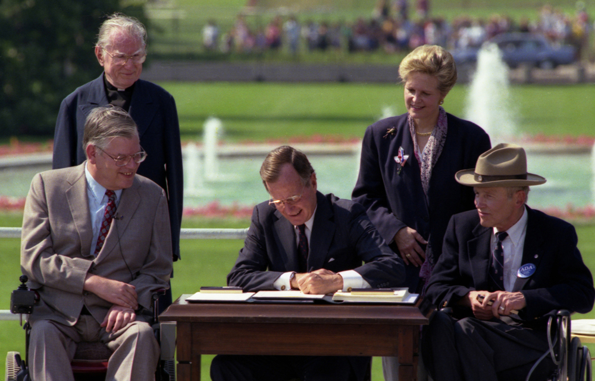
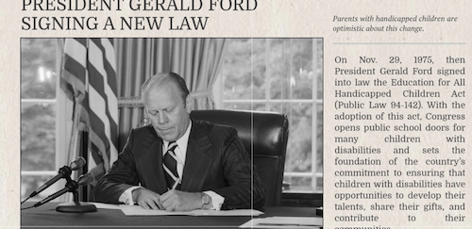
Look back but look forward with determination and hope

