Slide 1
Supporting College Students with Autism
Kenzie Billeiter, MS
Doctoral Candidate, School Psychology

Slide 2
Introduction and Background
Welcome and thanks for being here! ☺
PhD candidate in School Psychology
MA in Clinical Psychology and MS in School Psychology
Worked at OALA for the past 4 years while completing doctoral coursework
Provide academic, behavioral, emotional, and social support to students with autism through individual and group sessions as well as evidence-based curriculums

Slide 3
Agenda
Welcome and Overview
Baylor’s Mission Statement
Diversity at Baylor University
Projected Rates of ASD at Baylor
Statistics and Outcomes
My Role at OALA
Common Issues and Barriers
Tips for Working with Students on the Spectrum
Resources
Discussion

Slide 4
Baylor’s Mission Statement
The mission of Baylor University is to educate men and women for worldwide leadership and service by integrating academic excellence and Christian commitment within a caring community.

Slide 5
Diversity at Baylor University
Baylor’s overall student body is the most diverse ever at the University, with overall minority enrollment rising to about 34%
Where do we stand with other kinds of diversity?
How does our campus accommodate differences in cognitive processes?

Slide 6
Projected Rates of ASD at Baylor
Rates of ASD in the US are around 1 in 44 (CDC, 2022)
Baylor officially enrolled 20,709 students as of Fall 2022
Based on the CDC’s rates, roughly 470 students at Baylor are on the spectrum!
About 45 are registered with OALA to receive services for ASD
About 20 request either weekly or biweekly meetings
Others check in 2-3x a semester

Slide 7
Statistics and Outcomes
Students with ASD are attending college at higher rates each year
Increased risk for academic and perceived personal failure during their college years
Decreased graduation and employment rates
Increased chance of developing comorbid psychological disorders
Primarily anxiety and depression
The core features and the psychological characteristics of ASD, coupled with new pressures and demands of higher education, bring significant challenges to students with ASD
Increasing independence, living in residence, navigating new social situations, adjusting to new classroom/lecture styles, etc.

Slide 8
My Role at OALA
Provide mental, social, behavioral, and academic support for college students, specifically those on the spectrum
This can take many forms:
PEERS for Young Adults
Weekly/Biweekly skills building with “homework”
Weekly check-ins
Social skills group
Collaborating with other departments and professors
Title IX, Counseling, Health Services, Engineering
Working through adaptive skills
Thinking about what’s next
Graduate school, career planning

Slide 9
Common Issues and Barriers
Identity and not wanting to “out” themselves as someone with ASD
Lack of a script for university life
K-12 and college have vastly different structures
Social dynamic
Peer acceptance/rejection and dating
Adaptive skills
Laundry, cooking, hygiene, transportation

Slide 10
Common Issues and Barriers (cont.)
Lack of primary support system
Integrating the family while maintaining the autonomy of the student
Finding a “chosen” family
Finding community
Proper documentation
Late diagnosis, misdiagnosis, etc.
Graduation and employment rates

Slide 11
Tips for Working with Students on the Spectrum
Reason for referral
This may be obvious, but their autism isn’t always the reason they are seeking help
Sometimes it can even function as a protective factor
Ask about preferences on person-first language
I approach this similarly to asking someone their preferred pronouns
When in doubt, mimic their language
Trying using neutral terms such as atypical or neurotypical
The neurodiversity movement has been great about introducing new, more empowering terminology
Avoid using terms like normal or high or low functioning, as these are not accurate and can be offensive

Slide 12
Tips for Working with Students on the Spectrum (cont.)
Check that your space sensory-friendly
Lights, textures, and smells
“What does autism look like for you?”
This acknowledges the variability within the spectrum and really opens the conversation such that the individual to express themselves instead of just describing a diagnostic label
Can also give you a clearer idea of what resources may be most helpful (e.g., social, academic, behavioral)
Reassess therapeutic techniques
Research has shown that some common therapeutic/rapport-building techniques such as mirroring can have reverse effects on those with atypical cognitive processes
I’ve found that being straightforward and literal is often the best approach
Offer them a script of what a meeting typically looks like and lay out each session beforehand

Slide 13
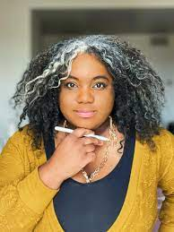
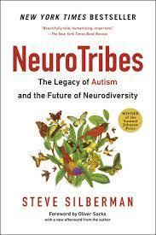
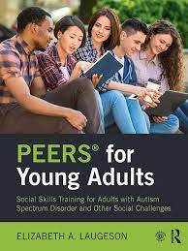
Resources
Autism in Adulthood
Research in Autism Spectrum Disorders
Morgan Harper Nichols
Autistic/ADHD artist
Temple Grandin
TED Talk: The world needs all kinds of minds
The autistic brain: Thinking across the spectrum
NeuroTribes
The Legacy of Autism and the Future of Neurodiversity
PEERS for Young Adults
Social Skills Training for Adults with ASD and Other Social Challenges

Slide 14
What are your experiences?

